Slide 1
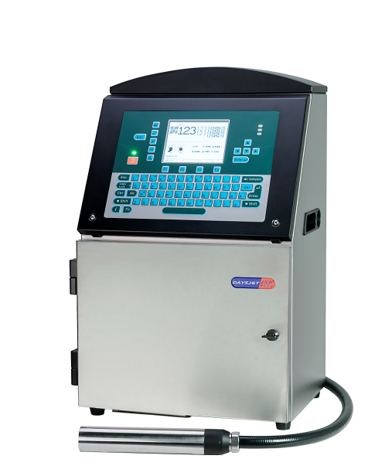
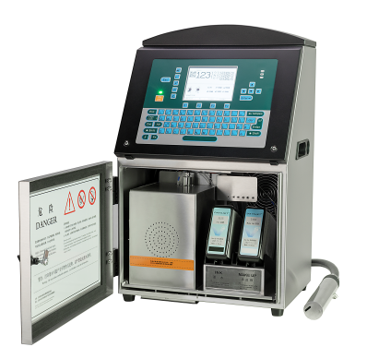
Continuous Inkjet GRENTSUN 18 Series
GRENTSUN 18 series continuous ink jet printers are designed for long-running times to ensure production line is not stop. Advanced technology can realize automatic setting and ink system automatic cleaning; Designed to make maintenance easier than ever.
Advantages of long trouble-free
• Advanced assembly and reliable spare parts ensure product reliability and consistency.
• The high integration of the ink circuit ensures the stability of the product. Greatly reduce the printer's failure and improve customer's production efficiency.
• Automatic cleaning when the machine is turned on and off greatly reduces the failure rate of the printer, minimizes the user's intervention in the equipment during use, and truly realizes maintenance-free equipment. Fast start-up is possible even after long shutdowns.

Slide 2
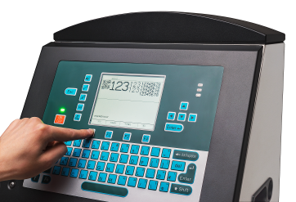
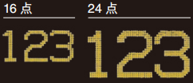
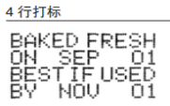
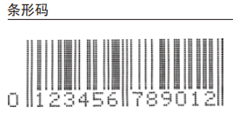
Flexible coding and excellent printing
• 18 series printer's advanced ink drop positioning technology provides the best print quality and print speed.
• The printing content is diversified. Images, bar codes, data matrix codes, shifts, tower printing, etc. meet customers' needs for various encodings.
• Convenient information editing and input. Printing 1-5 lines to meet customer needs.
• USB data printing, database import U disk, you can print on demand.
Print example

Slide 3
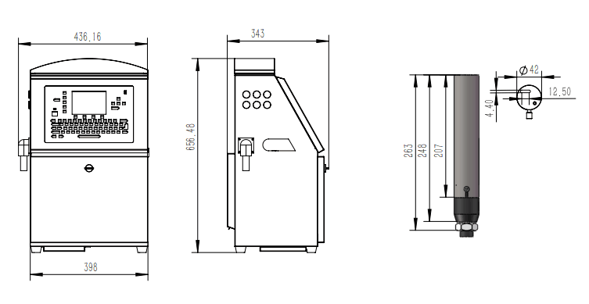
Specification
Model | 1830PLUS | 1860 | 1870 | 1850
Language | Chinese /English
Nozzle diameter | 60u | 40u | 50u | 60u
Nominal character height | 2 -12mm | 0.8-7mm | 1 -13mm | 2-12mm
Ink type | Dye |  |  | Pigment
Maximum line | 5 | 4 | 5 | 4
Font matrix configuration | 5/7/9/12/16/24/32 | 5/7/9/12/16/24 | 5/7/9/12/16/24/32 | 5/7/9/12/16/24
Linear bar codes | CODE39、CODE128
Data Matrix codes | Data matrix 10X10,12X12,14X14,16X16，21X21,29X29
Data interface | RS232
Throw distance | 12mm | 6mm | 12mm | 12mm
Line speed capability | 396 | 160* | 396 | 396
Message storage | 100
Features | Clock, expiration date, shift code, automatic counter, bold characters and information, encoder, tower printing, round-trip printing, USB data printing, custom font
Print head umbilical | 2.5m
Electrical requirements | Nominal supply power 100-120 / 200-240 VAC at 50/60 Hz., 150 W
Temperature | 32°F to 122°F (0°C to 50°C)
Humidity range | 0% to 90% RH non-condensing
Environmental protection | IP55 stainless steel cabinet
Approximate weight | 35kg
Dimensions | 436×343×656mm（Width X depth X height）
Continuous improvement of products is the eternal policy of GRENTSUN. We reserve the right to change design and / or specifications without notice

